Slide 1
PTA/OTA 106
Unit 1 Lecture 4

Slide 2
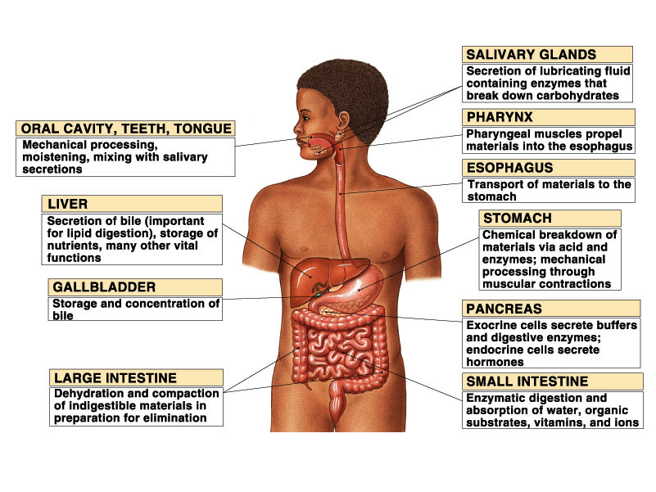
Overview of the Digestive System
Notes:
Figure 24.01
Title:
Digestive System Components
Caption:
Major regions and accessory organs
Notes:
Relationship and organization of digestive organs

Slide 3
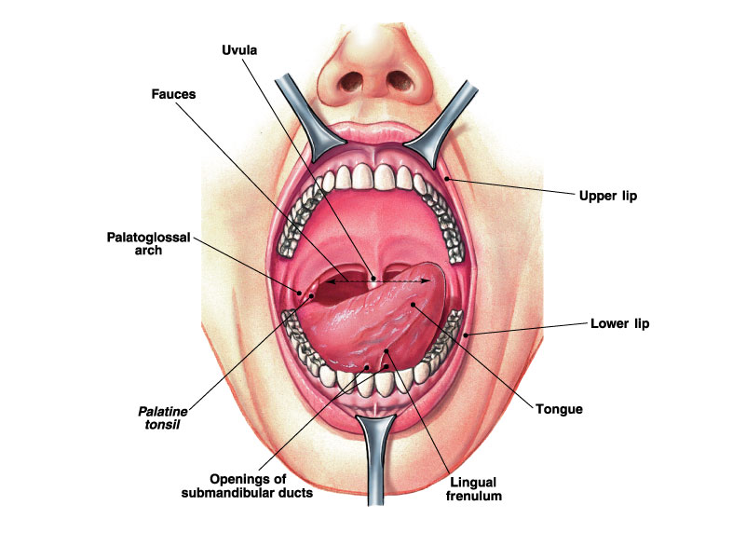
Internal Structures of the mouth
Notes:
Figure 24.06a
Title:
Oral Cavity
Caption:
Anterior view of open mouth
Notes:
An anterior view of the oral cavity shows the attachment of the tongue to the floor of the mouth (lingual frenulum) and the openings of salivary gland ducts in the floor of the mouth.

Slide 4
Internal Structures of the mouth

Slide 5
Salivary Glands and their Associated Ducts

Slide 6
Number and types of Adult Teeth

Slide 7
Location and Types of Deciduous Teeth

Slide 8
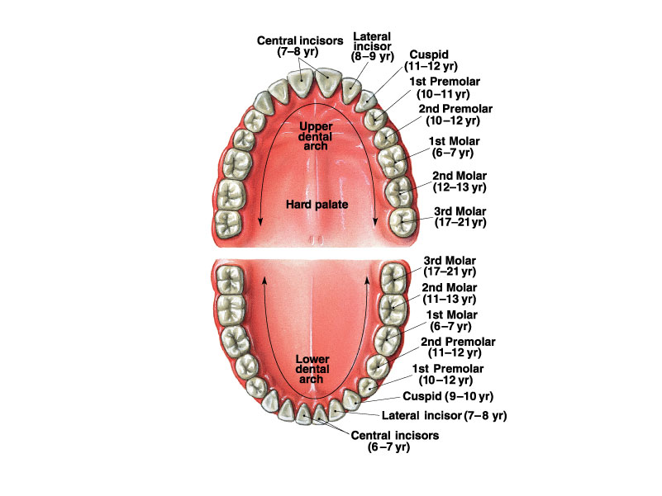
Location of Adult Teeth and Age of Eruption
Notes:
Figure 24.09b
Title:
Teeth: Primary/Secondary
Caption:
The adult teeth, with age at eruption given in years
Notes:
The second set of teeth, called permanent dentition, has 32 teeth, eight per side of the upper an lower jaw.

Slide 9
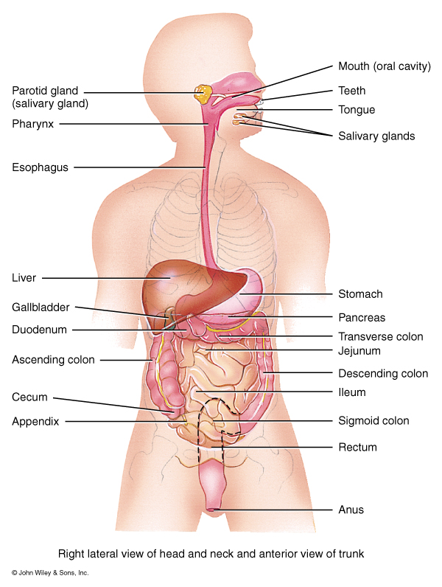
GI Tract Functions
Mouth: Ingestion
Teeth: Mastication
Salivary Glands:
Water: Moistens Food
Mucus: Lubricates and
binds food into bolus
Amylase: Starts break-
down of Starch and
Glycogen

Slide 10
GI Tract Functions
Mouth continued:
Salivary Glands:
Lingual lipase: Starts
breakdown of lipids
Bicarbonate (HCO3):
Buffering action
neutralizes acidic food
in the mouth

Slide 11
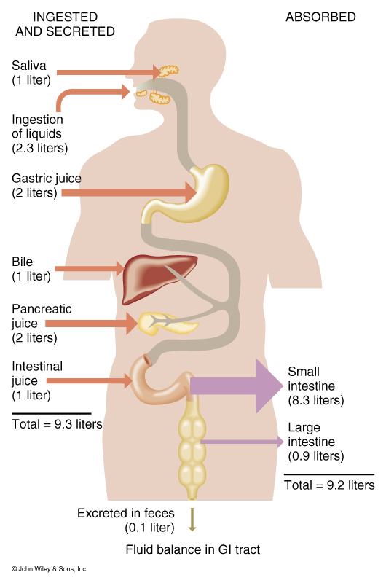
Overview of fluid intake and secretion compared to fluid absorption by the Digestive tract

Slide 12
GI Tract Functions
Pharynx: Both Oropharynx and Laryngopharynx:
Deglutition or Swallowing

Slide 13
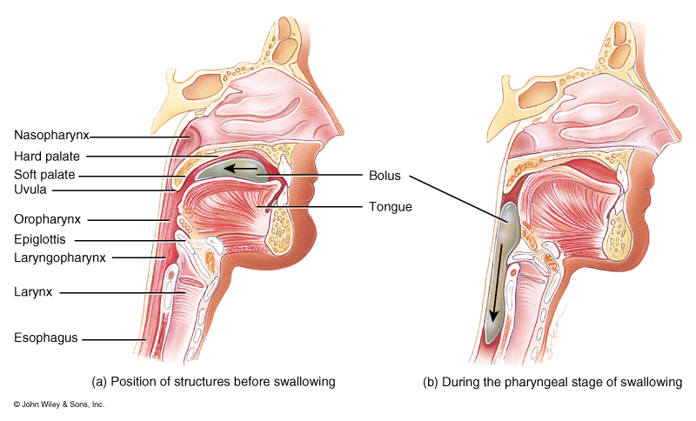
Stages of Deglutition
Voluntary Stage:
a. Buccal or Oral activity
formation and movement of the bolus

Slide 14
Stages of Deglutition
Pharyngeal Stage:
Soft-palate is pulled upward closing off the nasopharynx
Palatoglossal and palatopharyngeal arches are pulled medially forming a sagittal slit with the fauces.

Slide 15
Stages of Deglutition
Pharyngeal Stage:
Vocal cords close
Epiglottis swings backward over larynx and larynx is pulled upward to close off the opening of the larynx
Upper esophageal sphincter relaxes to that bolus can enter the esophagus.

Slide 16
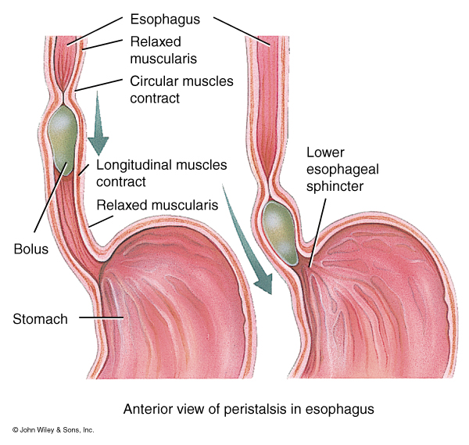
Stages of Deglutition
Esophageal Stage:
Peristalsis pushes the bolus downward through the esophagus.
Lower esophageal sphincter relaxes and the bolus enters the stomach

Slide 17
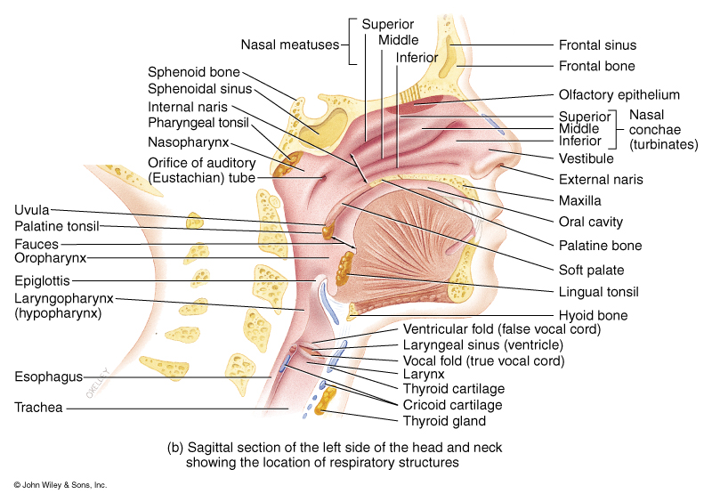
Structural Portions of the Respiratory System
Upper Respiratory System
Designed to conduct air into and out of the Lower Respiratory System

Slide 18
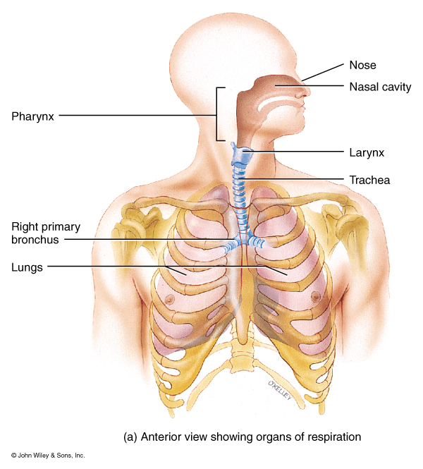
Processes of the Respiratory System
Pulmonary ventilation
mechanical flow of air into and out of the lungs
External Respiration
exchange of gases between the pulmonary air spaces and the blood
Internal Respiration
exchange of gases between blood and tissues

Slide 19
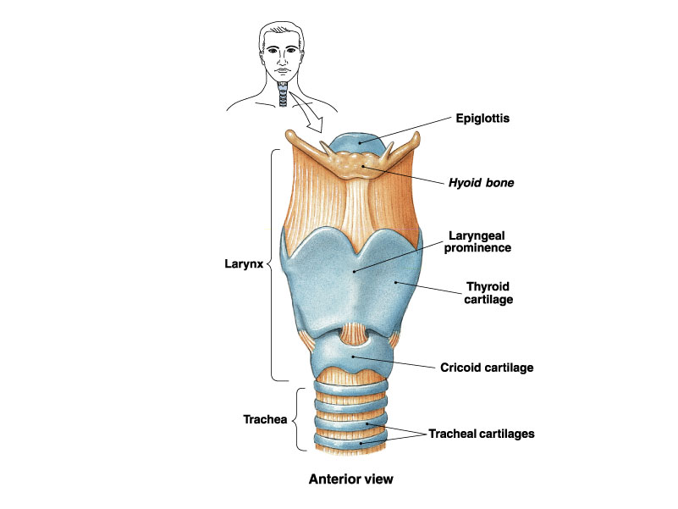
Anterior view of the Larynx

Slide 20
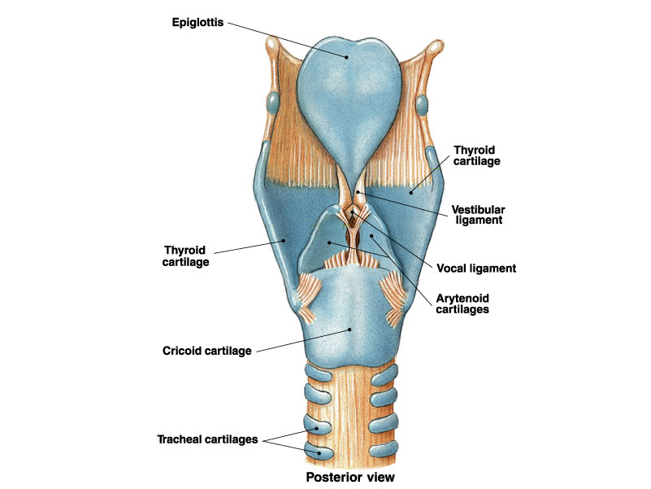
Posterior View of the Larynx

Slide 21
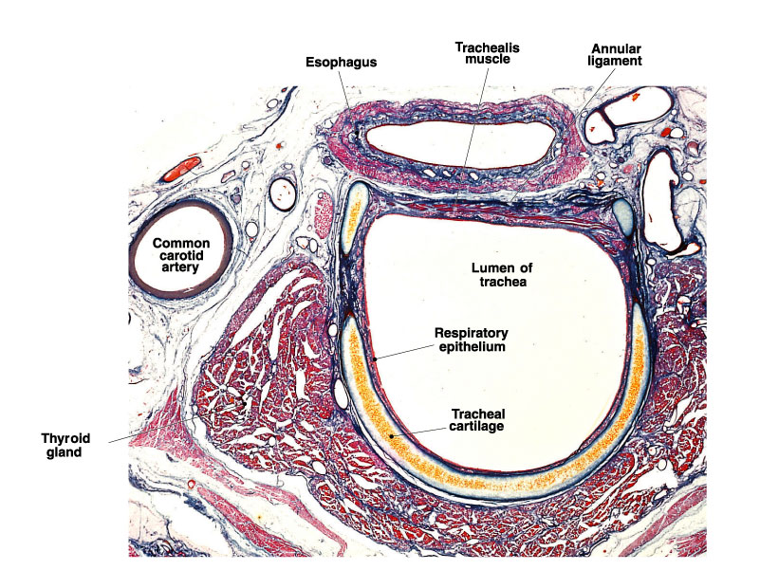
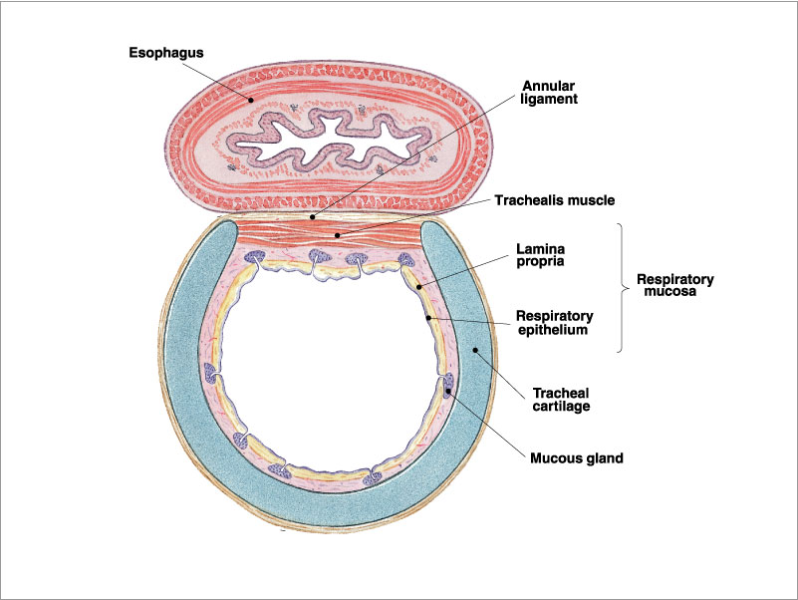
Relationship of the Esophagus and Trachea in the Neck

Slide 22
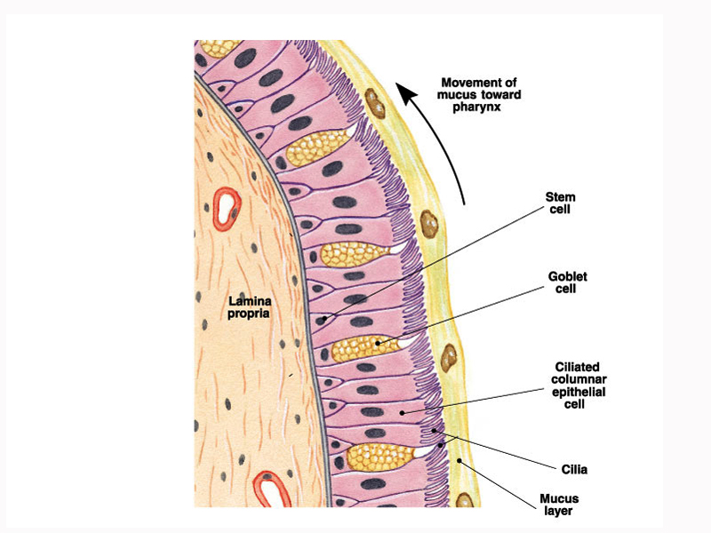
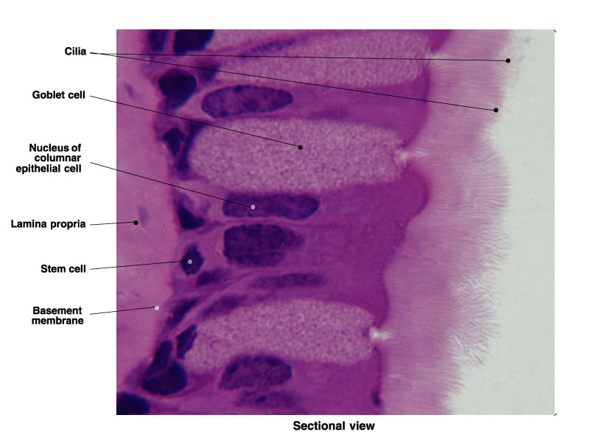
Pseudostratified Ciliated Columnar Epithelium

Slide 23
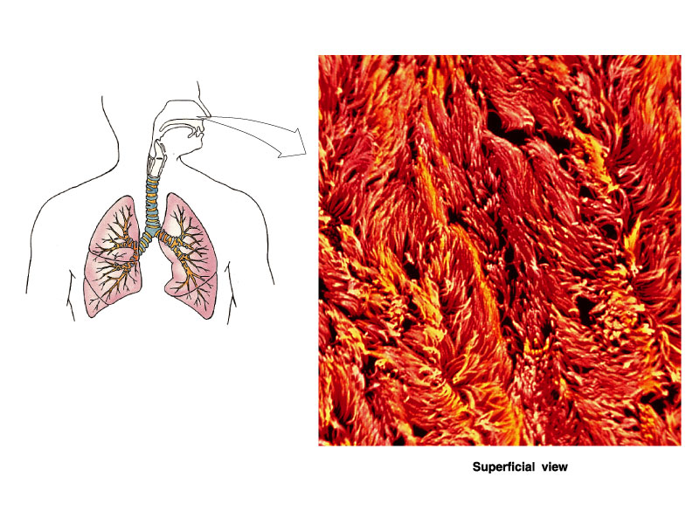
Surface View of the lining of the upper Respiratory system demonstrating Pseudostratified ciliated columnar

Slide 24
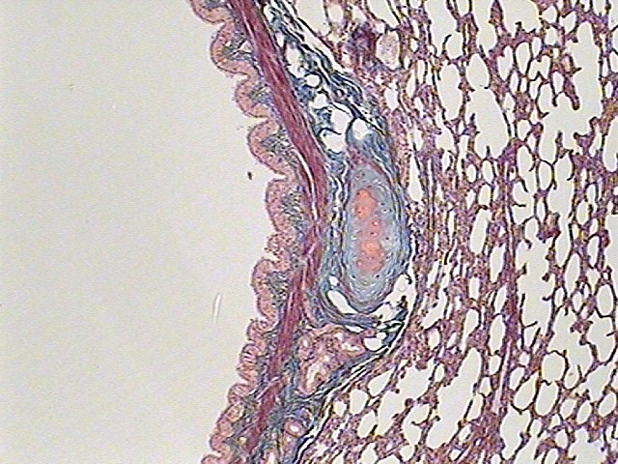
Histology of a Bronchiole showing a Seromucous gland

